Slide 1
Currying Lecture 6 part 1

Slide 2
This part’s goal
Goal: Understand how you curry a function.
Why this goal: By currying functions you make it possible to chain them together using composition. It also works well in combination with partial function application.

Slide 3
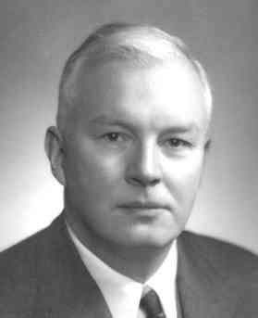
Yummy Curry!
No spicy functions... :(
Haskell Curry (1900 – 1982)
Mathematician who invented a lot of the mathematics behind functional programming.
Notes:
https://en.wikipedia.org/wiki/Haskell_Curry

Slide 4



Reminder: function composition
If a function has the same output type as another's input type they can be combined into one function.
Function
Function
Function

Slide 5
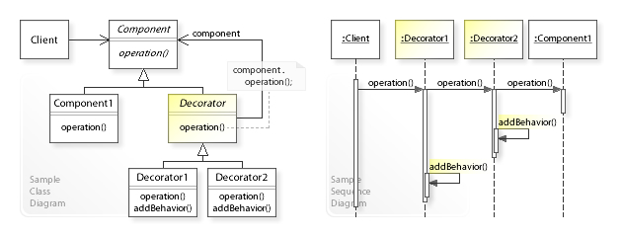
Reminder: Decorator pattern
“In object-oriented programming, the decorator pattern is a design pattern that allows behavior to be added to an individual object, dynamically, without affecting the behavior of other objects from the same class.”
https://en.wikipedia.org/wiki/Decorator_pattern

Slide 6
Decorator pattern
The decorator pattern can be implemented by function composition: we decorated the ‘isEven’ function with logging. The result still has the same signature: Int => Boolean!
def log[A](value: A): A = { println("Logging: " + value) value } def isEven(value: Int): Boolean = value % 2 == 0 def isEvenWithLogging(value: Int): Boolean = (log[Int] _ andThen isEven _ andThen log[Boolean] _)(value) isEvenWithLogging(3) // returns false and prints 'Logging: 3' and 'Logging: false'
Int
log
Int
isEven
Boolean
log
Boolean
Int
isEvenWithLogging
Boolean

Slide 7

Generic decorator pattern?
But what do we do with functions that have two parameters? Composition for decoration does not work for two parameters.
Can we not make a generic decorator pattern?
For example just write one generic log function to log everywhere in the program?
Int
log
Int
Function
Boolean
Boolean

Slide 8

All functions have 1 parameter!
We can turn any function with multiple parameters into functions with just one parameter.
This operation is called currying.

Slide 9
Currying
As an example let’s curry the add function defined here.
We take the first parameter ‘x’ and make a function ‘addCurry’ that returns an anonymous function that adds ‘x’ to its parameter. The parameter of the anonymous function is now ‘y’.
We turned 1 function with 2 parameters into 2 functions with 1 parameter each!
Int
add
Int
Int
def add(x: Int, y: Int): Int = x + y add(1, 2) // 3
Int
anonymous
Int
Int
addCurry
def addCurry(x: Int): Int => Int = (y: Int) => x + y addCurry(1) // Function Int => Int that adds 1 to its input addCurry(1)(2) // 3 (Note that we do two function calls here!)

Slide 10
Currying in Scala
// Uncurried function def add(x: Int, y: Int): Int = x + y // Curried with a lambda function def addCurryLambda(x: Int): Int => Int = (y: Int) => x + y val addCurryLambda5: Int => Int = addCurryLambda(5) // Curried by Scala (syntactical sugar) def addCurryScala(x:Int)(y:Int): Int = x + y val addCurryScala5: Int => Int = addCurryScala(5)
// Using the functions add(5, 2) // Returns 7 addCurryLambda(5)(2) // Returns 7 addCurryLambda5(2) //Returns 7 addCurryScala(5)(2) // Returns 7 addCurryScala5(2) //Returns 7

Slide 11

Wait… But why?
Currying a function is not useful in itself. But it makes some nice patterns possible!
These patterns often use partial function application, which is the topic of the next part.

Slide 12
This part’s goal
Goal: Understand how you curry a function.
Why this goal: By currying functions you make it possible to chain them together using composition. It also works well in combination with partial function application.

